Slide 1
Secure Data Hiding in Image Using Steganography
CAPSTONE PROJECT
Presented By: Rishika Bajaj
Student Name : Rishika Bajaj
College Name : NIMS University, Rajasthan
Department : Btech [Artificial intelligence and machine learning]

Slide 2
OUTLINE
Problem Statement
Technology used
Wow factor
End users
Result
Conclusion
Git-hub Link
Future scope

Slide 3
Problem Statement
The primary challenge in secure data hiding is embedding sensitive information within an image without altering its visual quality while ensuring strong security measures against unauthorized access and detection. Existing steganographic techniques may be vulnerable to statistical and visual analysis, leading to possible data breaches.

Slide 4
Technology used
Hardware used : Lenovo i5 12 GB/512 GB
Programming Languages used : Python
Libraries used : OpenCV, PIL[Pillow]
Image Format used : PNG
Cryptography method used : AES Encryption

Slide 5
Wow factors
Password – Protected Decryption
Direct Pixel Manipulation for Data Hiding
Lightweight and Fast Execution
Simple Encryption Mechanism

Slide 6
End users
Cyber Security and Ethical Hackers
Intelligence Agencies & Military
Banking & Finance Institutions
Software Developers & Security Researchers
Journalists & Whistleblowers
Lawyers & Legal Professionals
Digital Artists and Content creators
Medical Industry (Steganography in Medical Imaging)

Slide 7
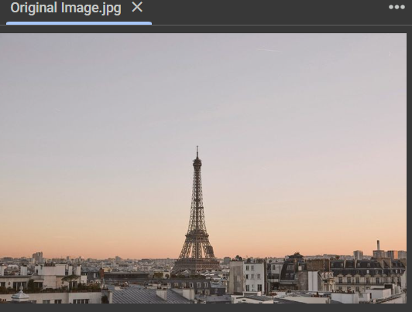
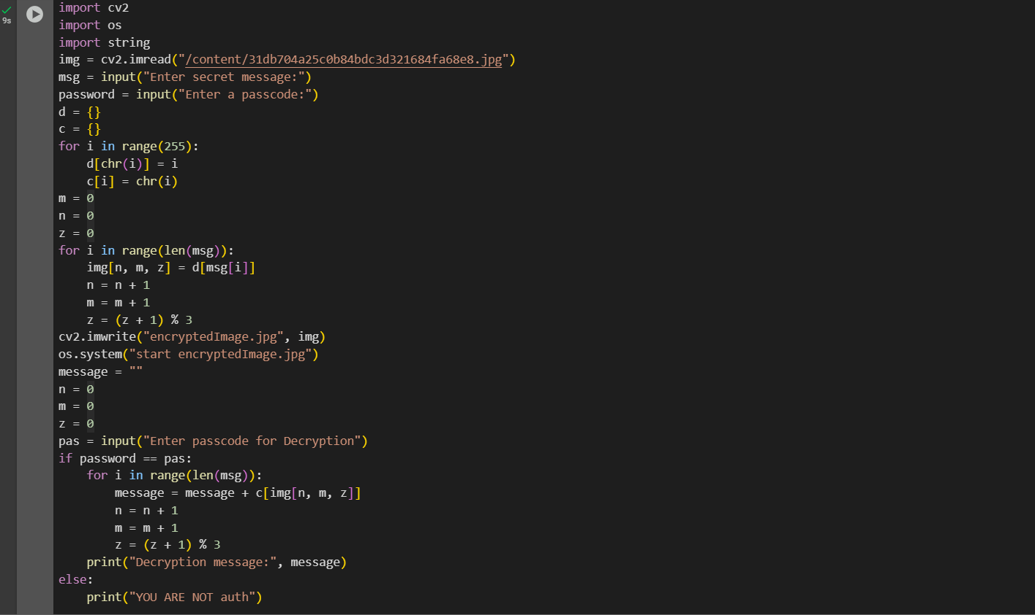
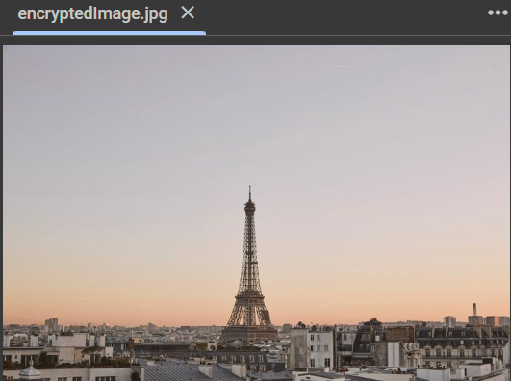

Results

Slide 8
Conclusion
In today's digital world, ensuring confidential communication and data security is more critical than ever. Traditional encryption techniques can protect data, but they do not hide its existence, making them susceptible to detection and attacks. Steganography provides a covert method of communication by embedding secret messages within digital images, ensuring that sensitive information remains undetectable.

Slide 9
GitHub Link
https://github.com/RishikaBajaj31/AICTE-Cyber-Security-Project

Slide 10
THANK YOU

